Slide 1
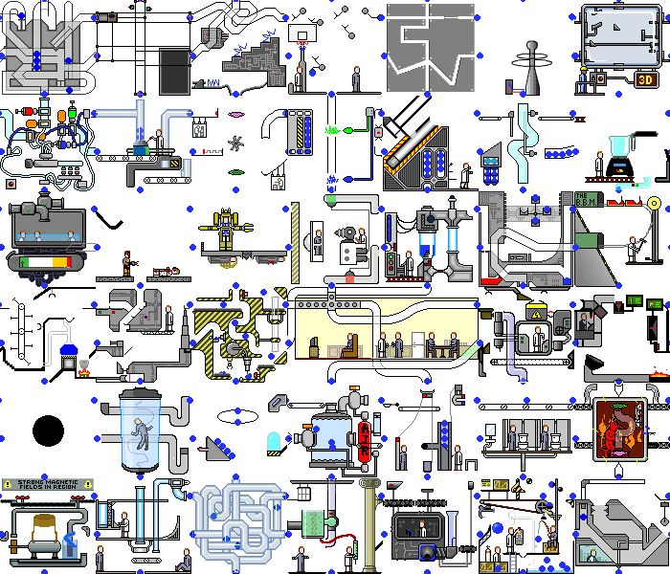
GPars:
Unsung Hero of Concurrency in Practice
http://playstationna.i.lithium.com/t5/image/serverpage/image-id/432281iDADEAFC04868CE5C?v=1.0

Slide 2
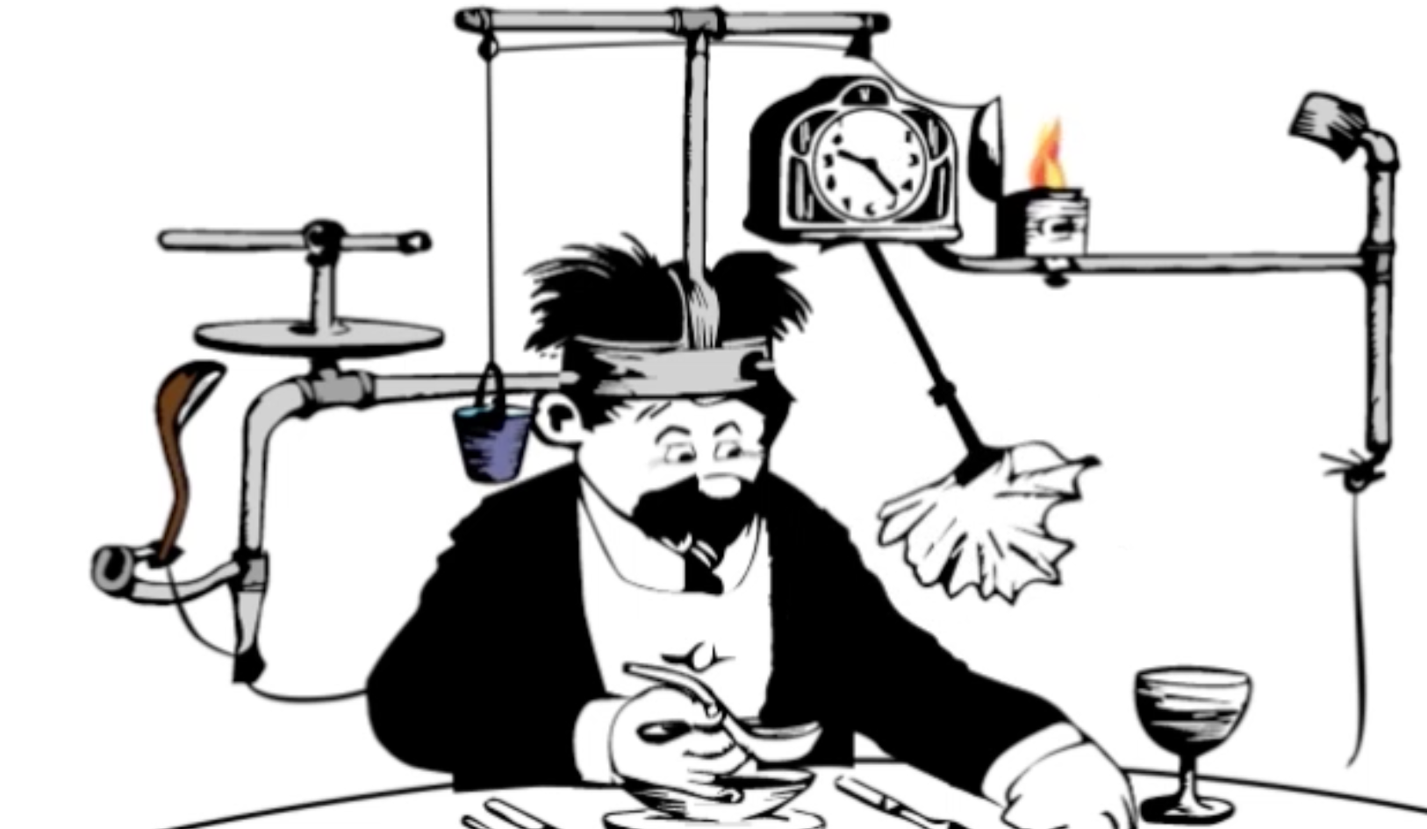
Yaroslav Yermilov Senior Software Engineer EPAM Systems https://yermilov.github.io/ https://twitter.com/yermilov17 https://www.facebook.com/yaroslav.yermilov https://ua.linkedin.com/pub/yaroslav-yermilov/58/682/506
work for EPAM Systems since 2011 in office - clustering, Big Data and automated testing out of office - Groovy
https://motherboard.vice.com/en_us/article/inside-rube-goldberg-machine-youtube-video-artist-joseph-herschers-bedroom-workshop

Slide 3
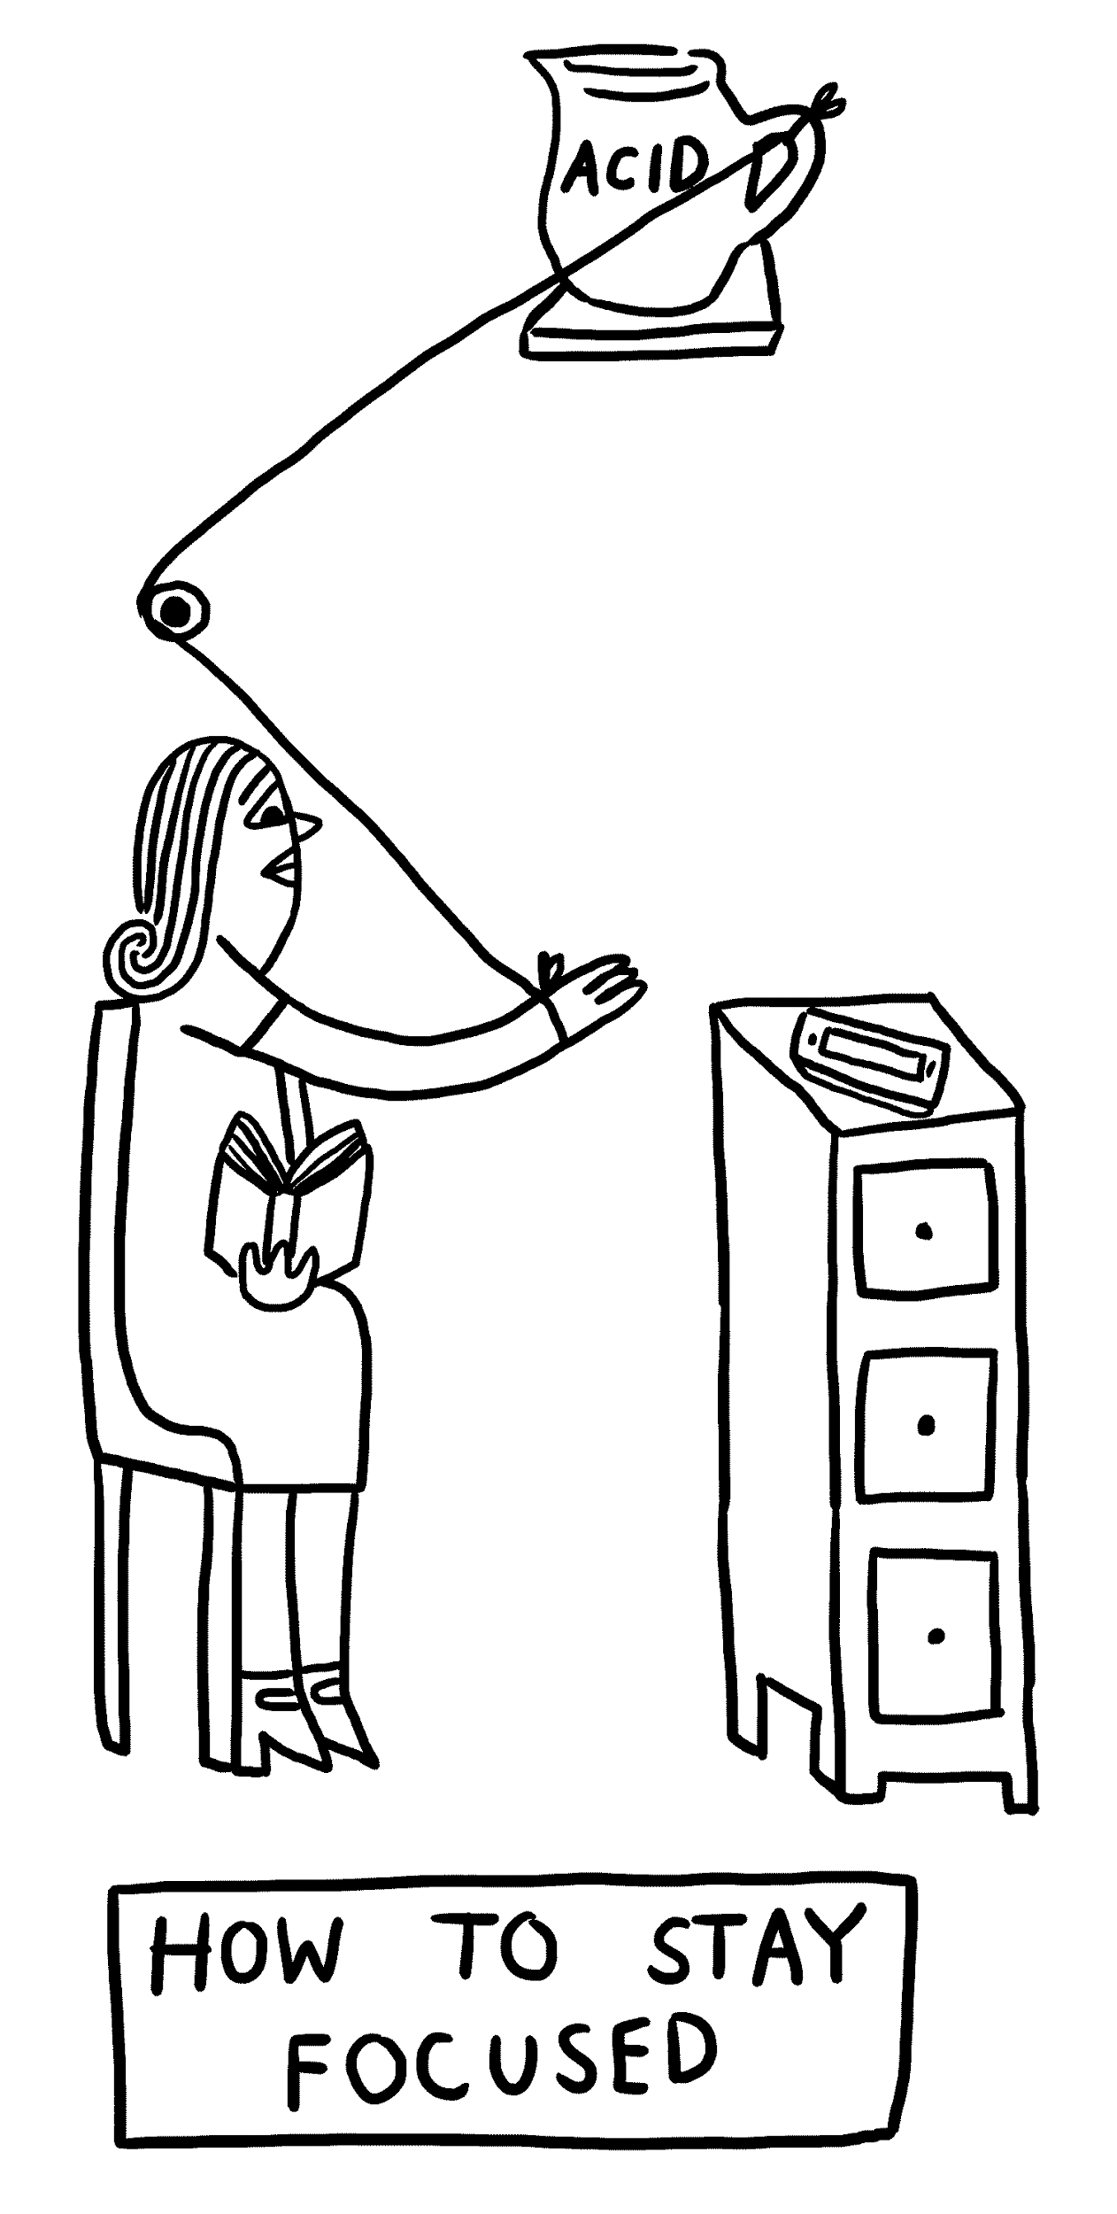
Focus for this talk
obey Moore’s law
how Java handles concurrent/parallel development?
GPars place in this picture
how GPars handles concurrent/parallel development?
why and when use GPars?
why and when do not use GPars?
http://www.theverge.com/2015/4/22/8381963/rube-goldberg-machine-contest-history-ideas

Slide 4
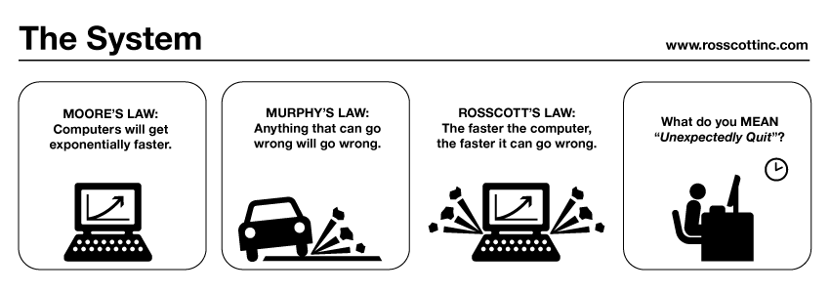
http://www.systemcomic.com/2009/04/27/the-system-197

Slide 5
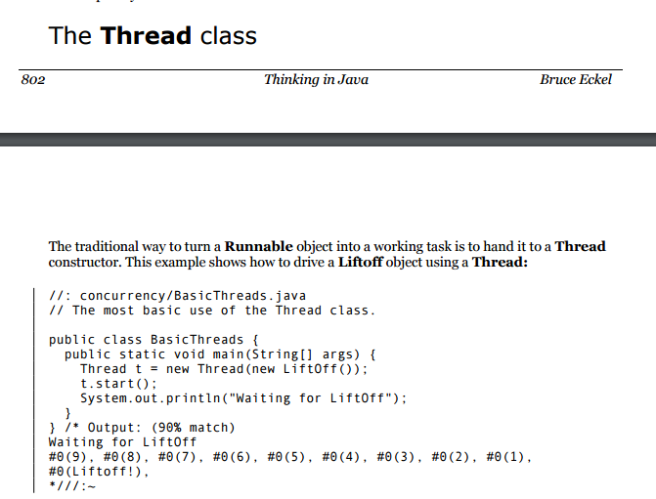

Slide 6
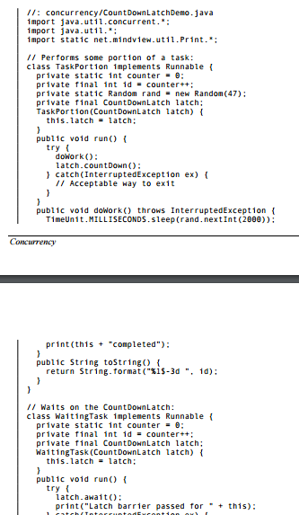
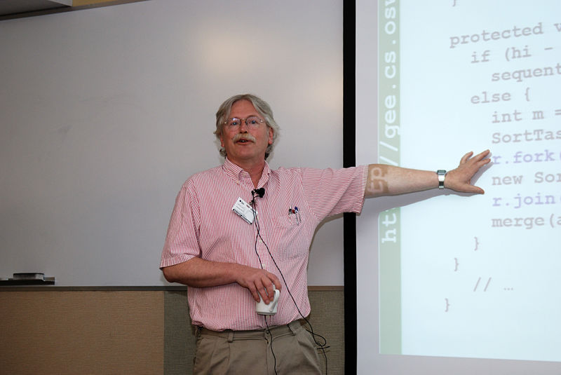
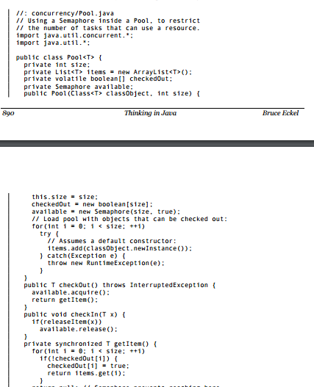
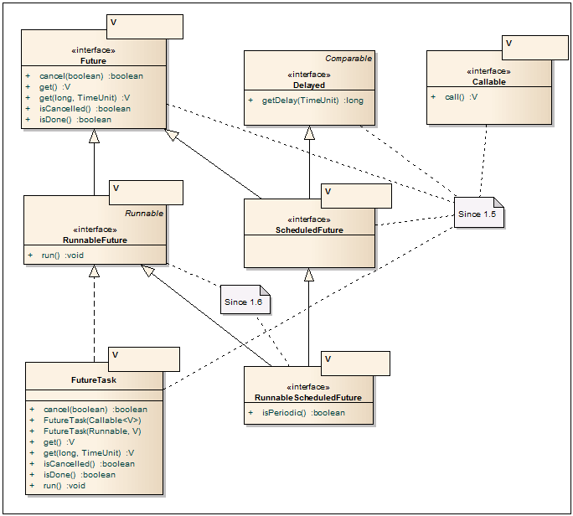
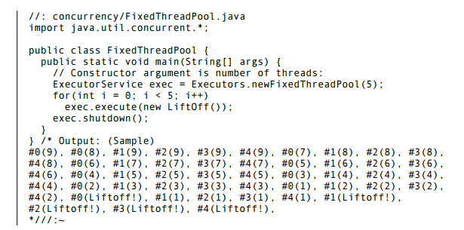
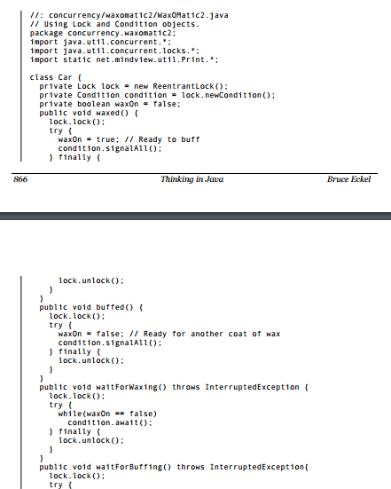
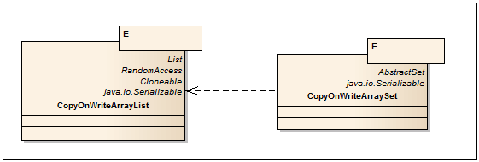
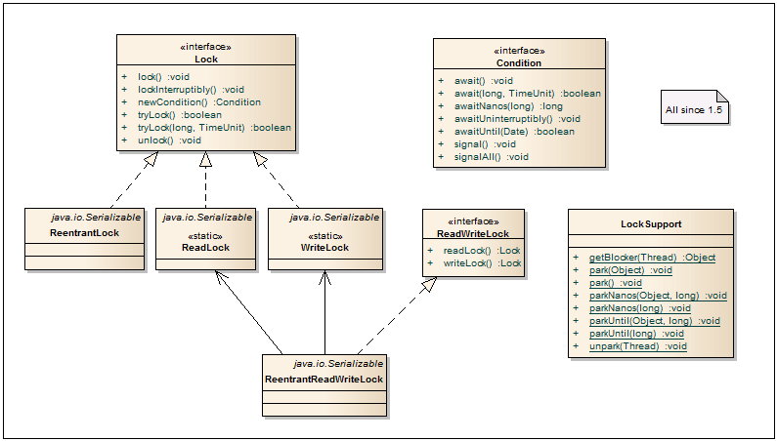
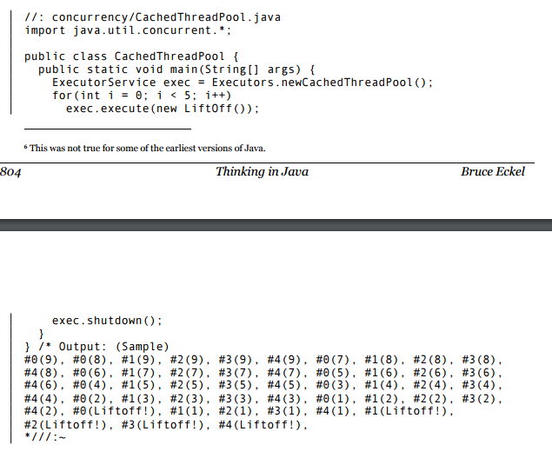
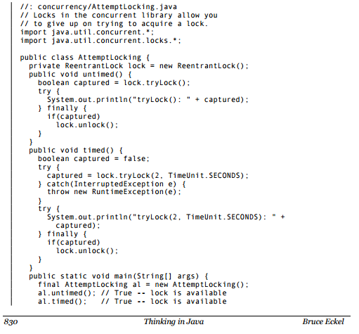
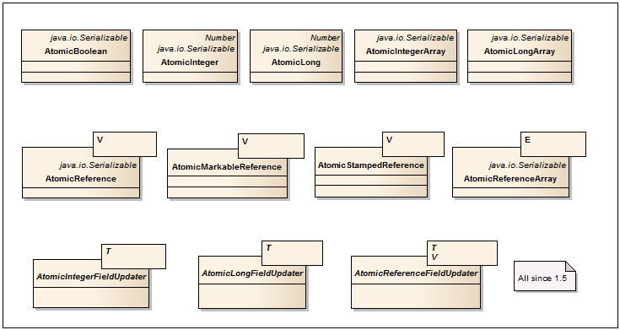
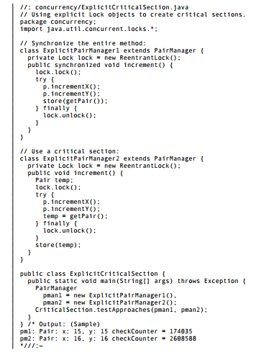
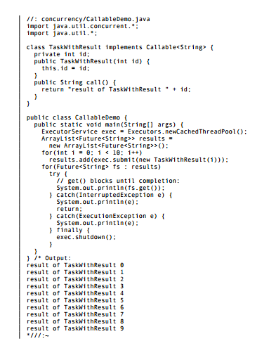
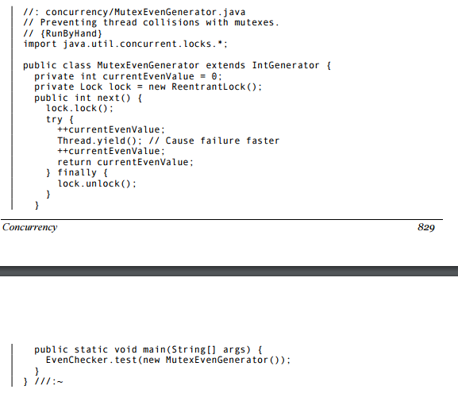
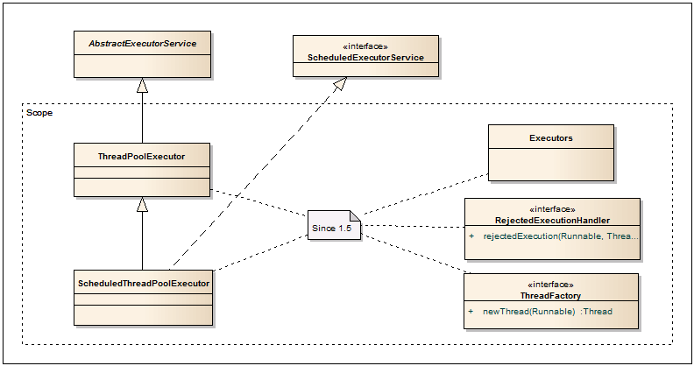
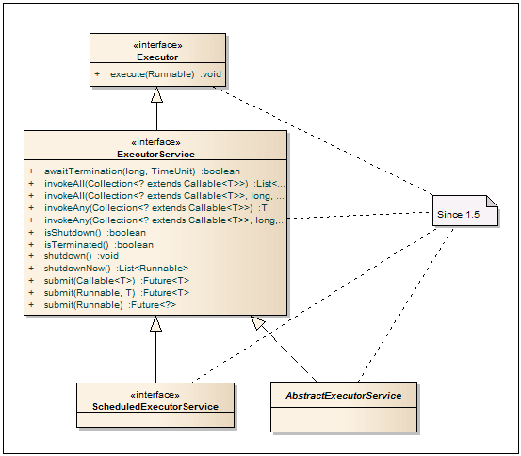
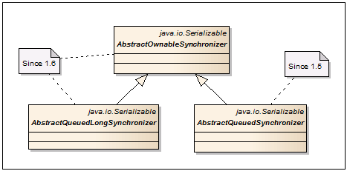
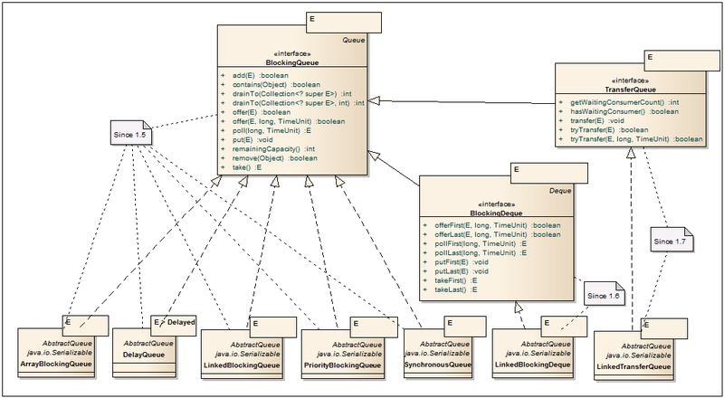
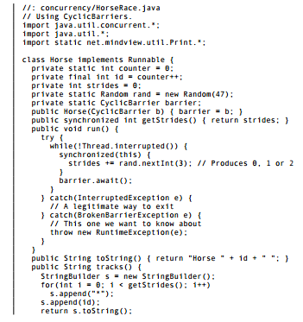
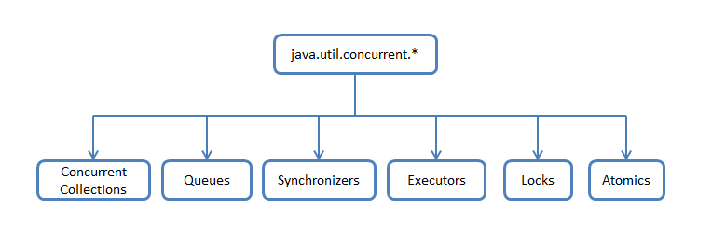
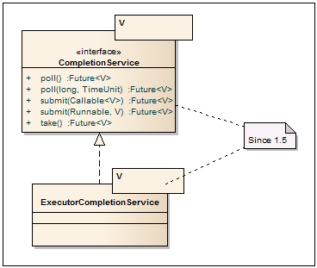
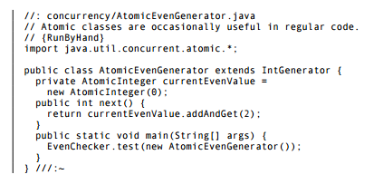
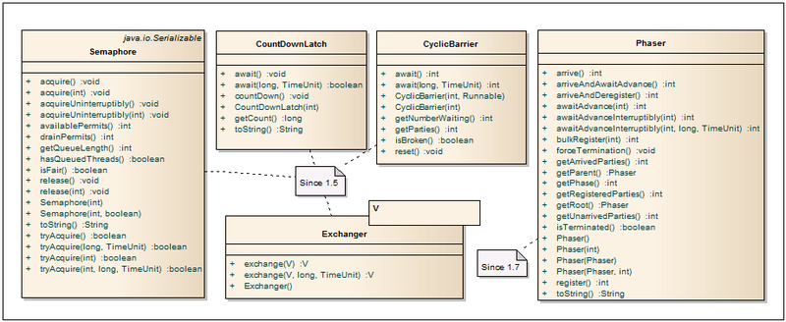
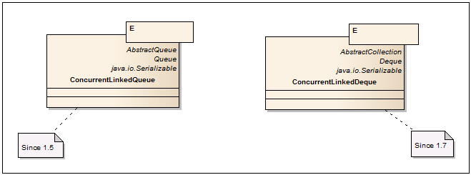
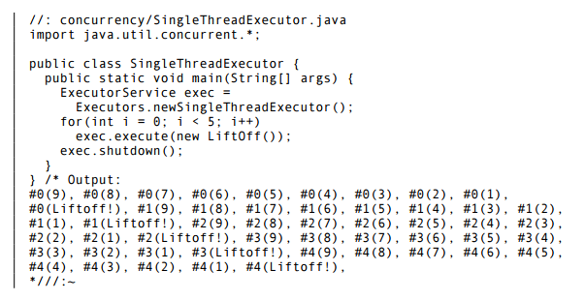
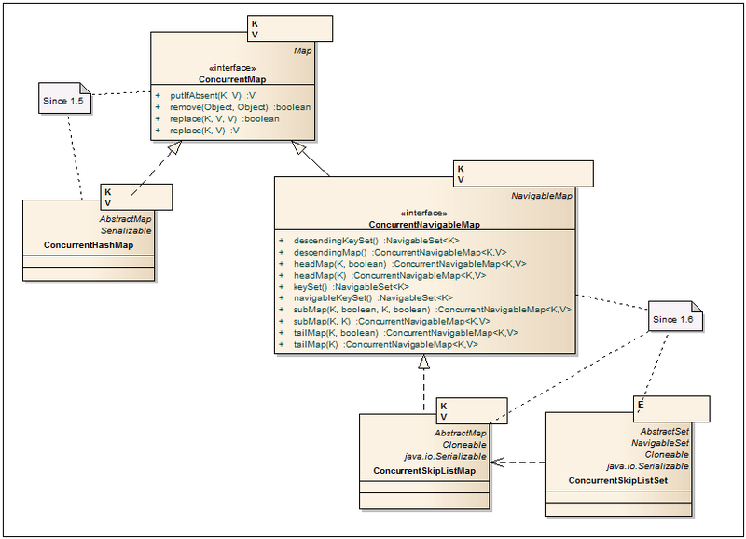
https://habrahabr.ru/company/luxoft/blog/157273/

Slide 7
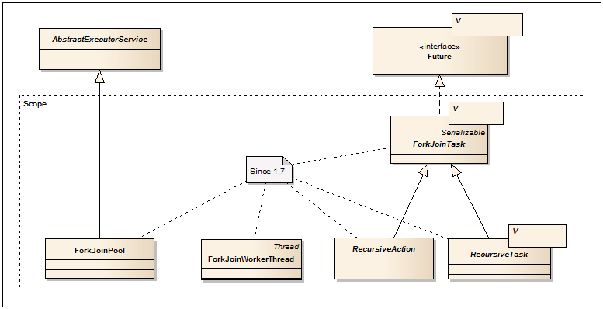

Slide 8
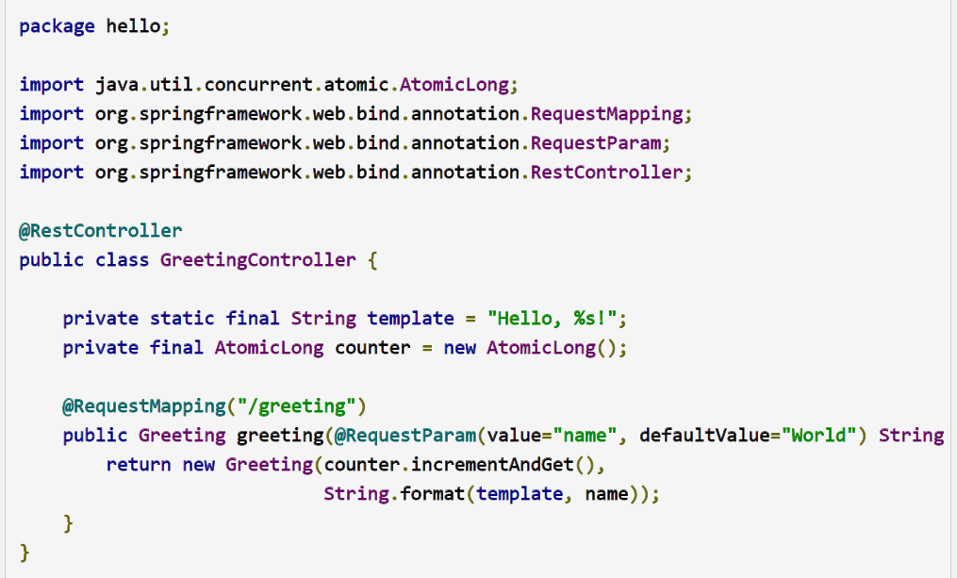
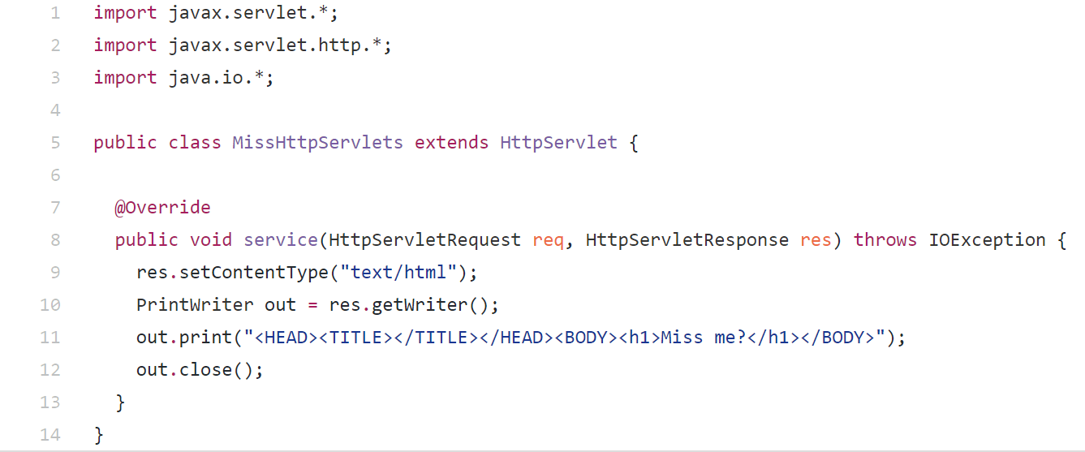

Slide 9
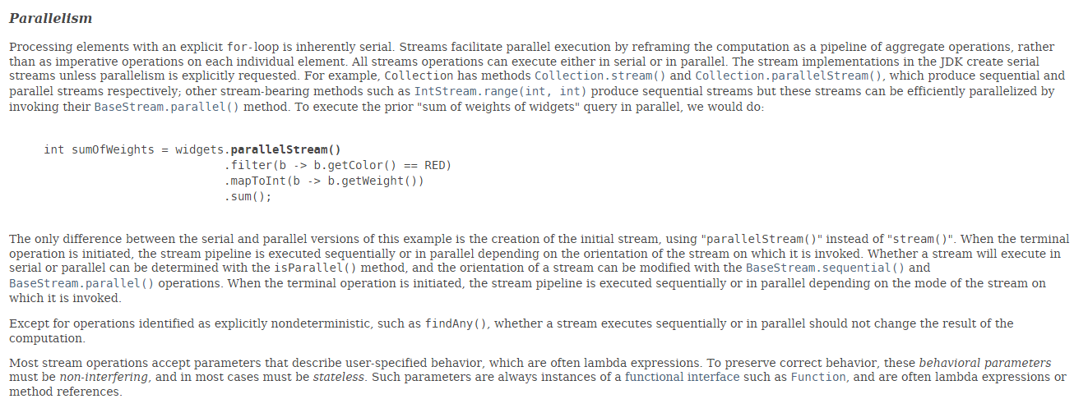

Slide 10
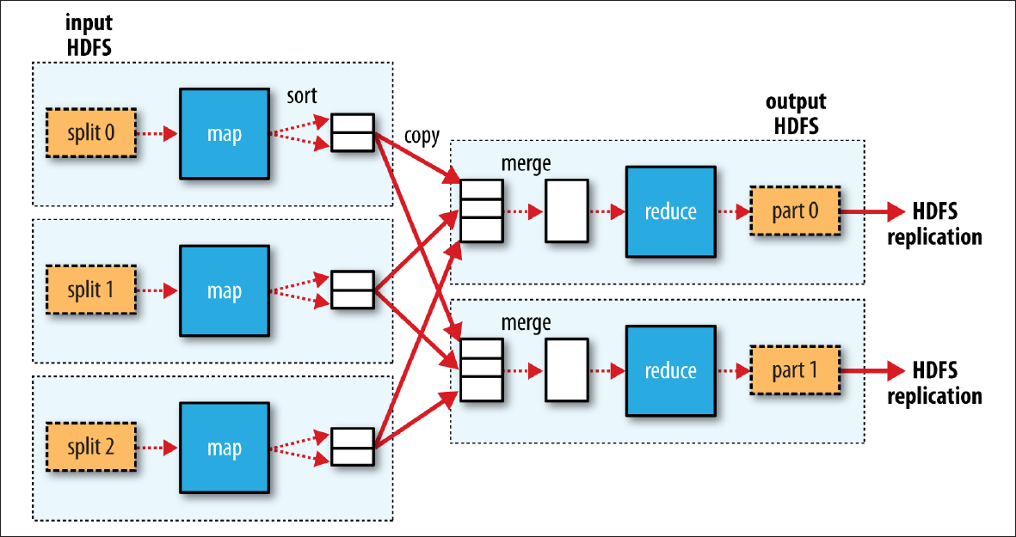

Slide 11
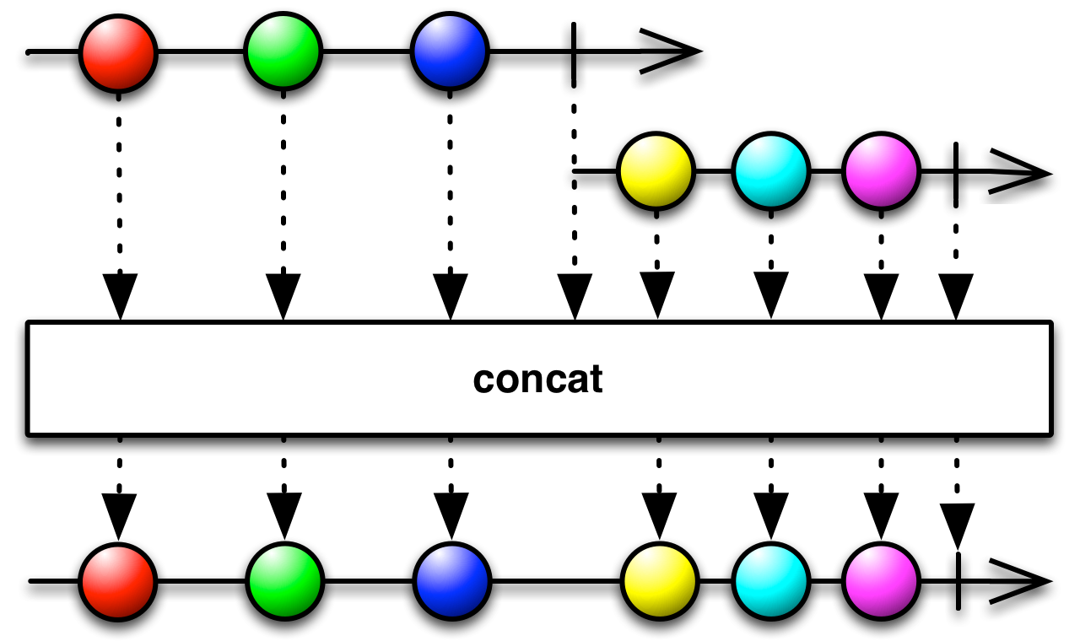
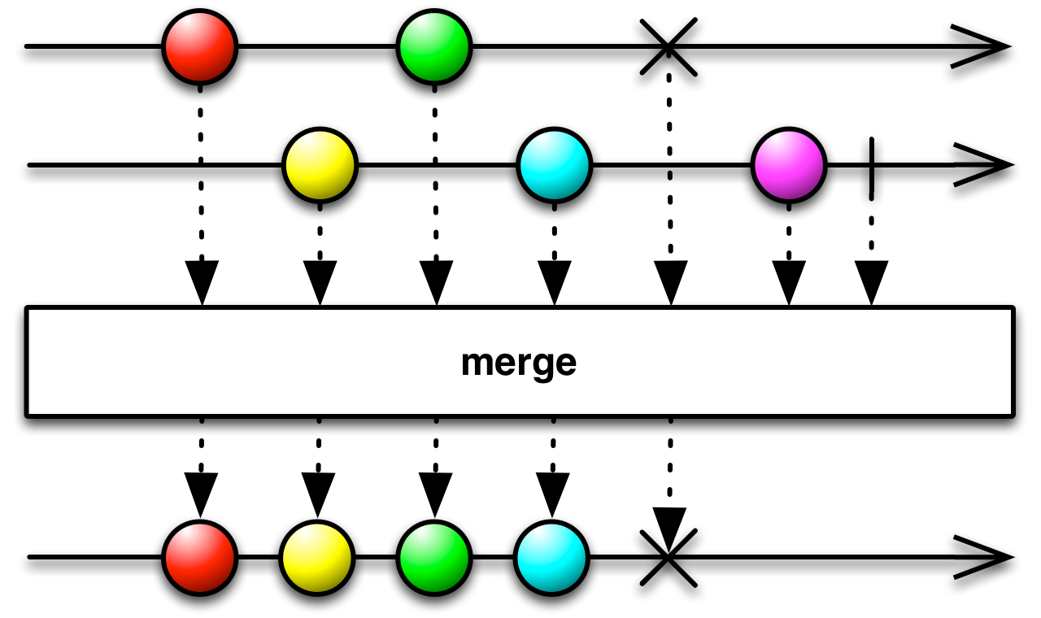
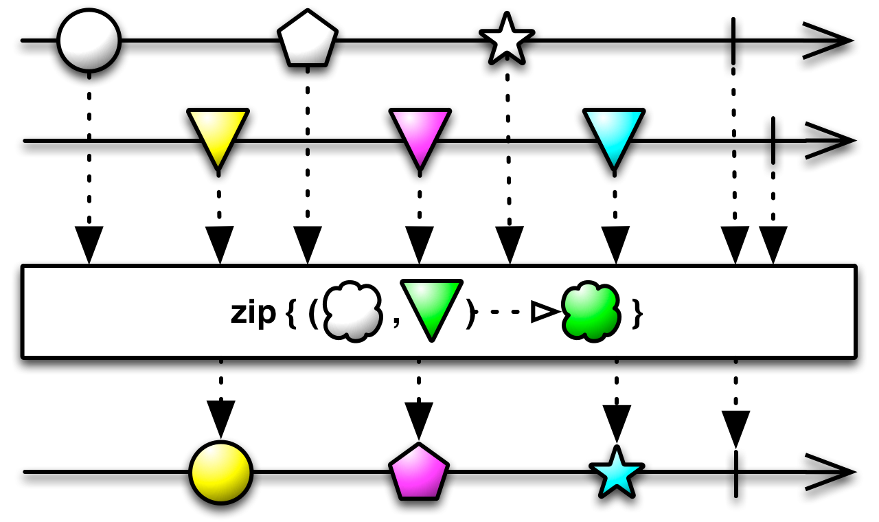
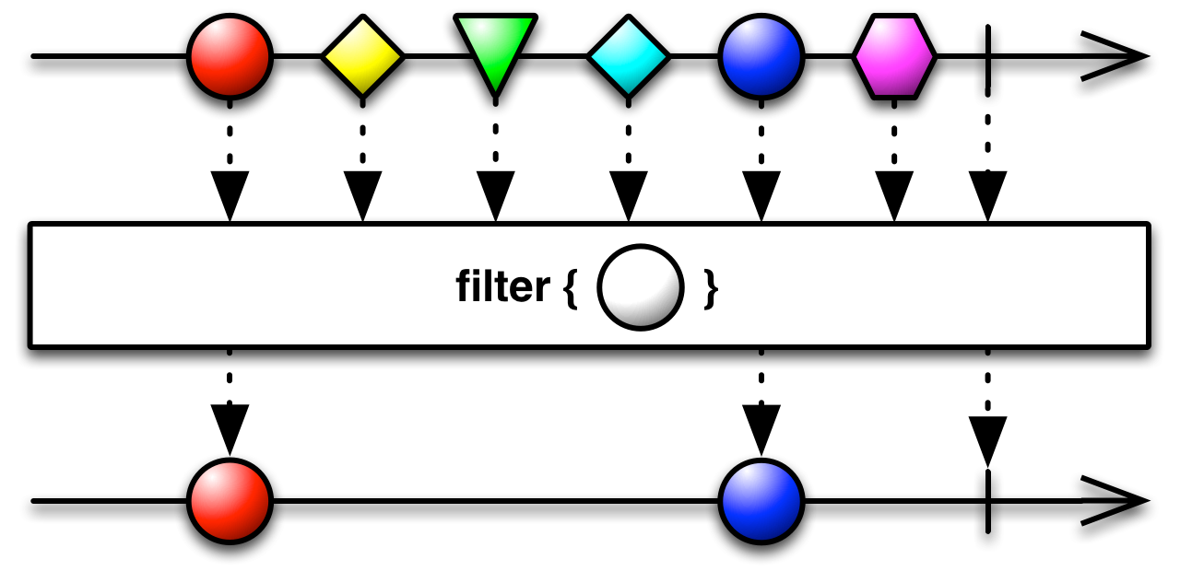
http://reactivex.io/RxJava/2.x/javadoc/io/reactivex/Flowable.html

Slide 12


Slide 13
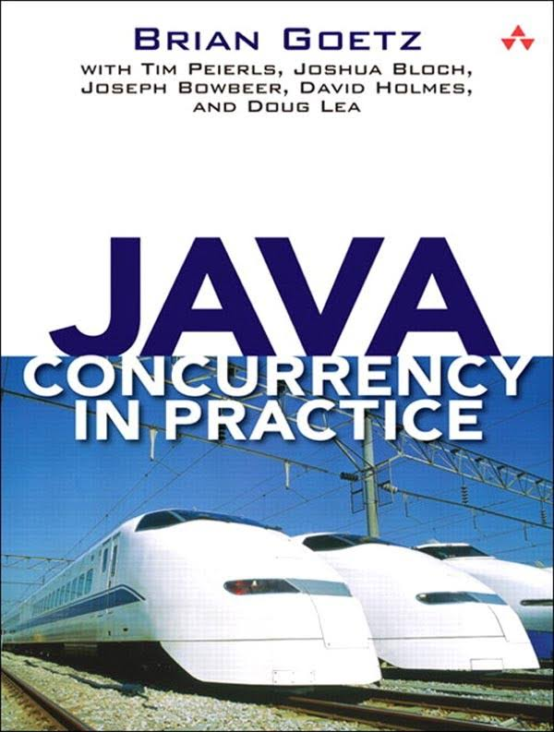
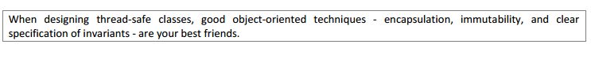
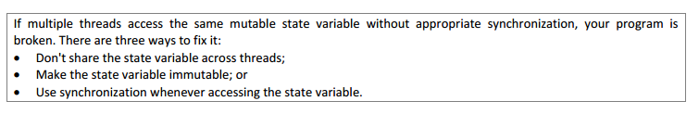

Slide 14
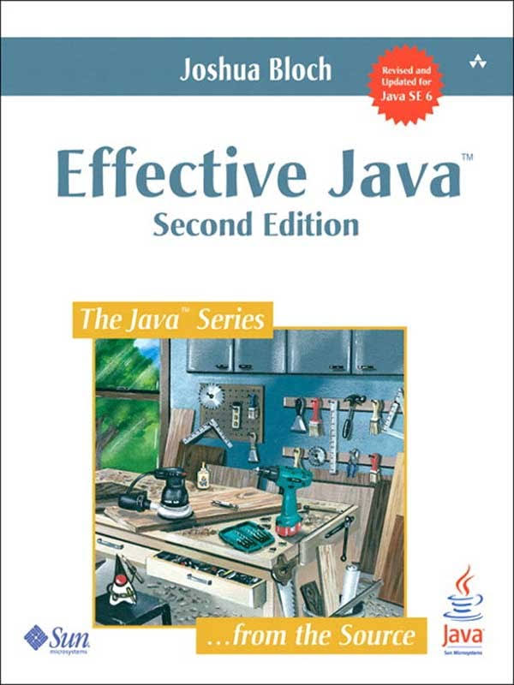
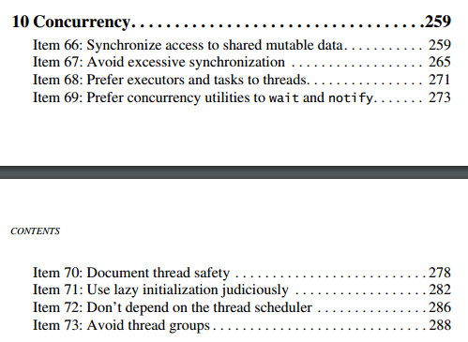

Slide 15
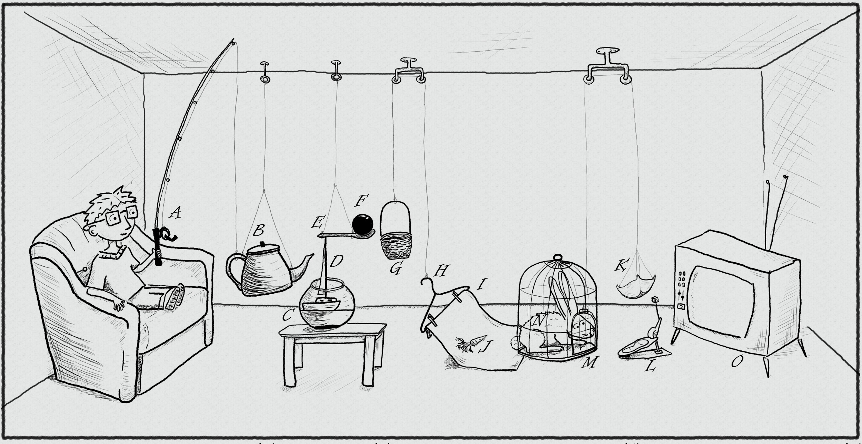
The traditional thread-based concurrency model built into Java doesn’t match well with the natural human sense for parallelism.
https://www.pinterest.com/pin/395190936024778319/

Slide 16
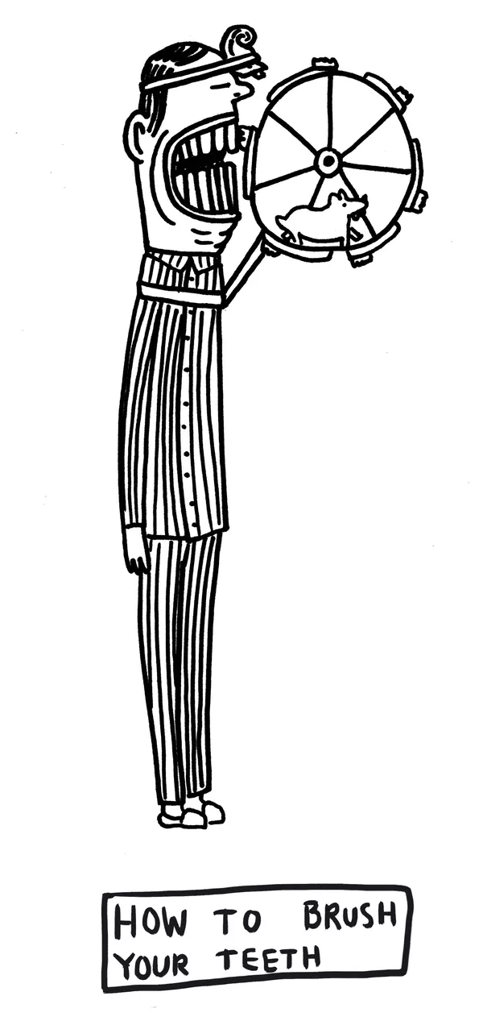
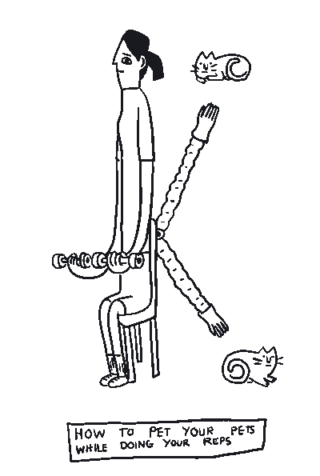
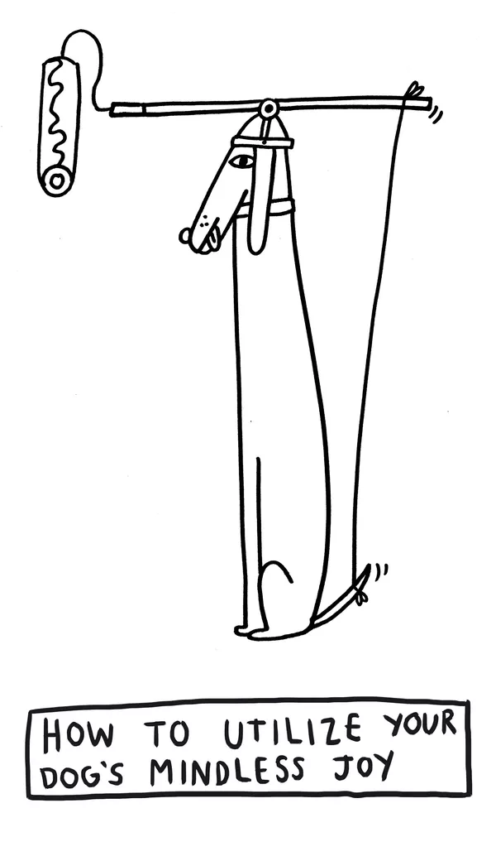
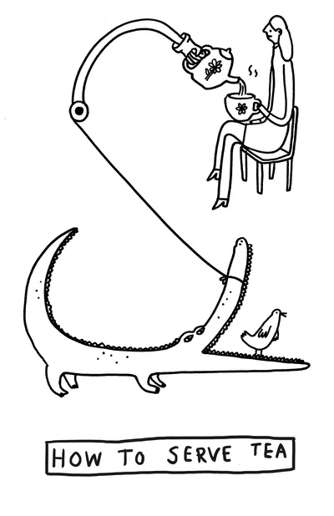
GPars:
map/reduce fork/join asynchronous closures actors agents dataflows
http://www.theverge.com/2015/4/22/8381963/rube-goldberg-machine-contest-history-ideas

Slide 17

DEMO
https://www.pinterest.com/pin/527554543837493577/

Slide 18


Slide 19


Slide 20


Slide 21


Slide 22


Slide 23


Slide 24


Slide 25


Slide 26


Slide 27


Slide 28


Slide 29


Slide 30
why and when use GPars?

Slide 31
why and when do not use GPars?

Slide 32
Further dive

